Slide 1
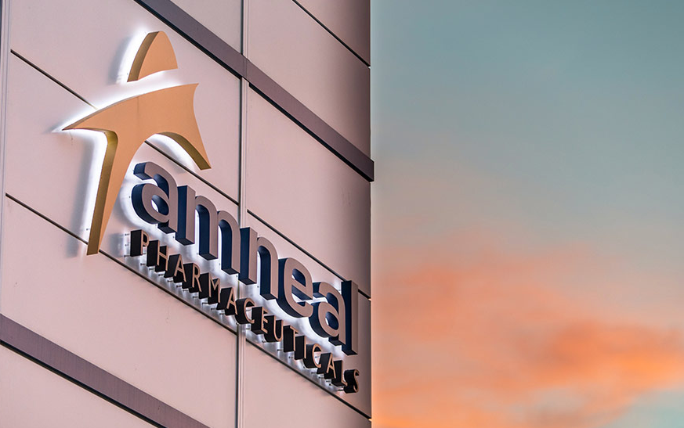

Gender Pay Gap Report Ireland Operations
We make healthy possible

Slide 2
Executive summary
In line with Ireland’s Gender Pay Gap Information Act 2021, we are sharing the results of the 2025 gender pay gap report. The report analyses the salaries of the entire workforce as one group, and not by job level, from the highest to the lowest salary across Amneal Ireland. The report reveals an overall gender pay gap of 24%, reflecting differences in average hourly earnings between men and women across our organization and reflects broader structural factors such as role distribution and seniority levels. While this gap highlights areas for improvement, we remain committed to fostering a more equitable workplace through targeted initiatives in recruitment, career development, and pay transparency. Our goal is to ensure that all employees have equal access to opportunity and reward.
What is a Gender Pay Gap?
The gender pay gap refers to the difference in average earnings between men and women in the workforce, typically expressed as a percentage of male earnings. It is calculated by comparing the mean and/or median hourly wages or annual salaries of men and women. This gap can result from various factors including occupational segregation, differences in working hours, and unequal access to leadership positions. Rather than indicating unequal pay for the same role, it highlights broader systemic inequalities that affect women's earning potential over time.

Slide 3
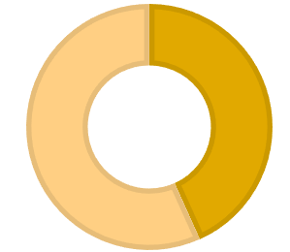
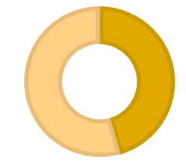
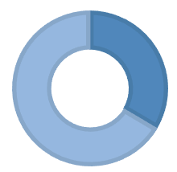
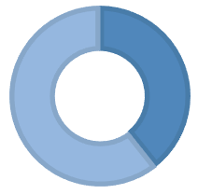
Reporting categories
Gender Pay Gap
Proportion Paid Benefits in Kind (BIK)
24%
Mean gender pay gap (All)
16%
Median gender pay gap (All)
100%
% of Male employees who received BIK
100%
% of Female employees who received BIK
Bonus Gender Pay Gap
Proportion of Paid Bonuses
100%
% of Male employees paid bonuses
100%
% of Female employees paid bonuses
50%
Mean gender pay gap (All)
35%
Median gender pay gap (All)

Slide 4
Quartiles
As part of Ireland’s gender pay gap reporting, we calculate quartile distribution by ranking all employees based on their hourly pay and dividing them into four equal-sized groups, or quartiles, from highest to lowest pay. Each quartile represents the distribution of salaries and not the number of people in each quartile, and the chart highlights the percentage of male and female salaries.
Male
Female

Slide 5
Reason for our Gender Pay Gap
Gender Pay Gap Statement
We acknowledge that our Gender Pay Gap and Bonus Gap are primarily driven by the composition of our workforce, where 42% of employees are female. This disparity is largely attributable to the distribution of roles within our organization, with a higher proportion of male employees currently occupying senior-level and higher-paying positions. We recognize that this imbalance reflects broader structural and historical trends, rather than differences in pay for equal work. Our commitment is to foster a more equitable workplace and to actively address the underlying factors contributing to this gap.
Role Levels | Male as a % of Role | Female as a % of Role
Executives | 100%
Managers | 55% | 45%
Professionals | 56% | 44%
Production/Support | 55% | 45%

Slide 6
Our commitment
Our goal is to ensure that higher-level roles within the organization are increasingly accessible to women, and that all employees—regardless of gender—have equal opportunities to thrive. To support meaningful progress, we are implementing the following initiatives:
Leadership Development: We will target leadership programs to support the progression of women into senior roles.
Recruitment & Promotion Review: We will evaluate our recruitment and promotion practices to ensure gender equity is embedded throughout.
Career Pathing & Mentoring: We are launching programs that provide clear career pathways and mentorship opportunities
Monitoring & Transparency: We will conduct regular internal audits and share transparent reporting to track progress and adjust our approach as needed.
We believe in the value of bringing new ideas, skillsets and perspectives to help power innovation and progress. Fostering an environment where all employees can bring their best selves to work and truly experience inclusion and belonging enables us to learn, grow and deliver even more value together. Addressing the gender pay gap is a key part of our broader strategy to build a fair, representative, and high-performing organization.

